Slide 1
Source Code
by Christian Laemmerhirt and Jackson Rosenthal

Slide 2
Features
Reddit clone for CS students for asking and answering questions
Login and create an account
Create text posts
Upvote / Downvote posts
Comment on each post
Upvote / Downvote comments
Manage user information

Slide 3
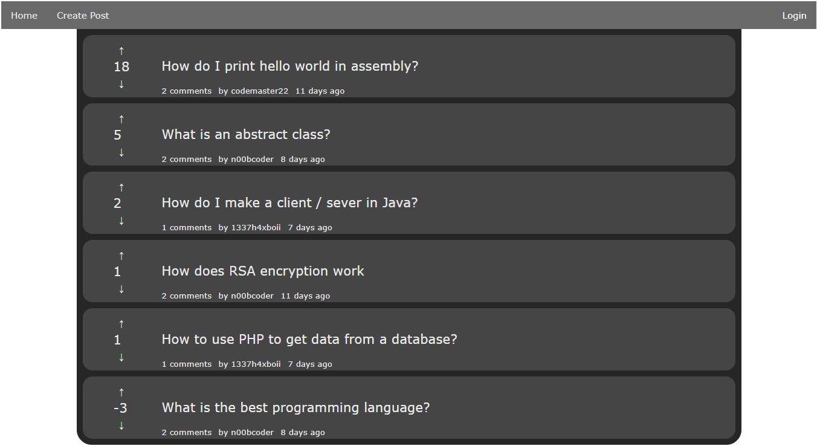

Slide 4
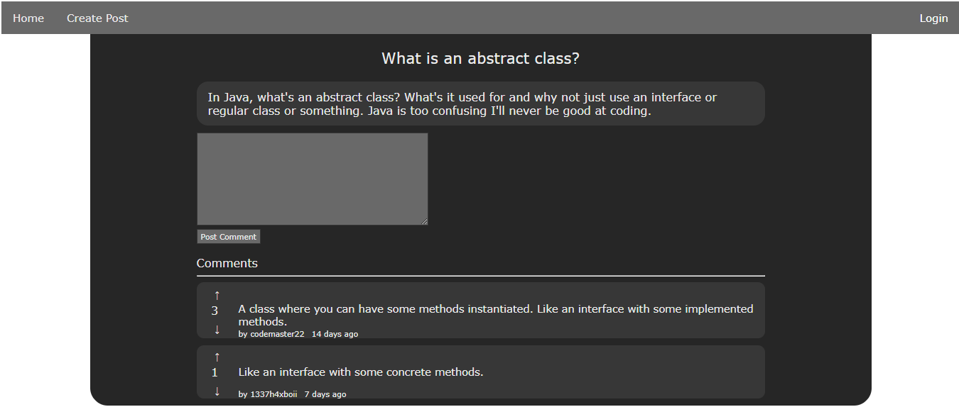

Slide 5
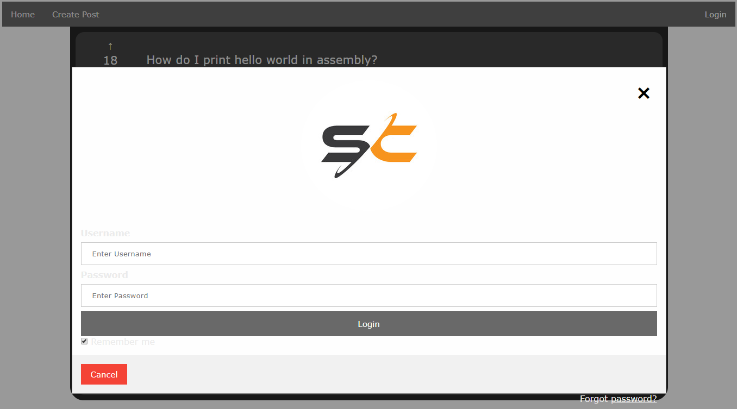

Slide 6
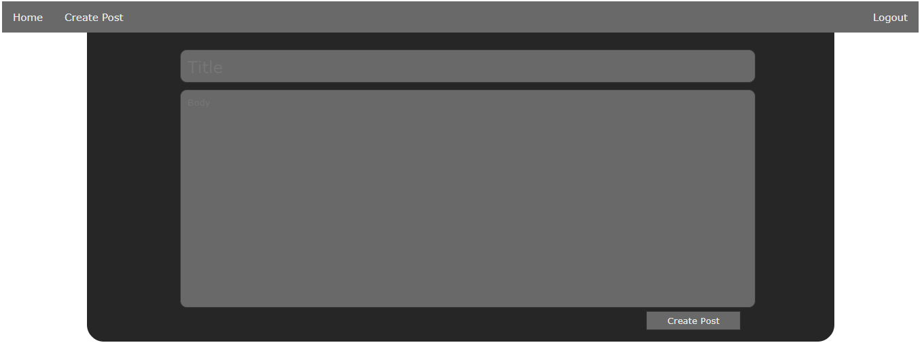

Slide 7
Technologies Used
HTML for website structure : Working
CSS for styling: Working
PHP to connect to the database and populate the page: Working
MySQL for the database: Working
Linux server setup on desktop VM to allow collaboration on source files: Working
Javascript for post confirmation and password changing: Working

Slide 8
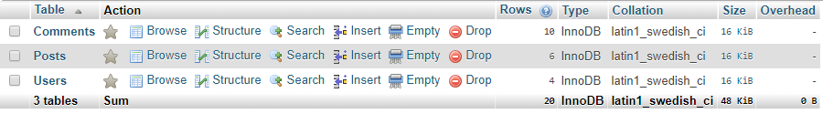
Database Tables
Comments
Post ID
Comment ID
Content
Points
Creator ID
Time Posted
Posts
Post ID
Title
Content
Points
Creator ID
Time Posted
Users
User ID
Username
Password Hash

Slide 9
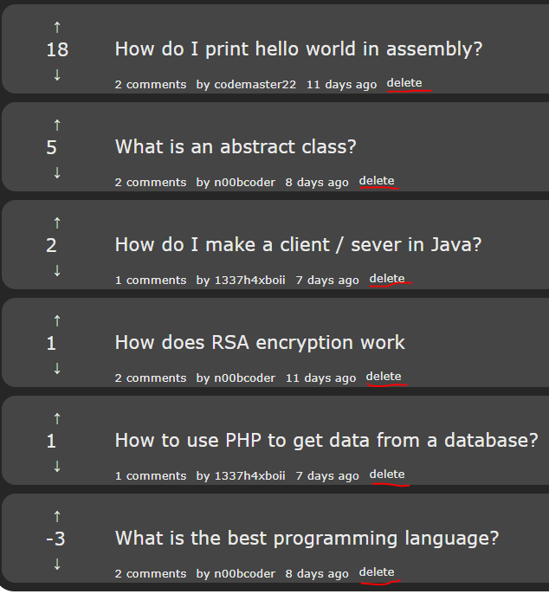
Web-Based Content Management
Our content management system is built into the site.
Logging in as the admin allows the user to delete any post or comment rather than just their own.
The admin also has access to an additional page that allows them to delete users and change their password.

Slide 10
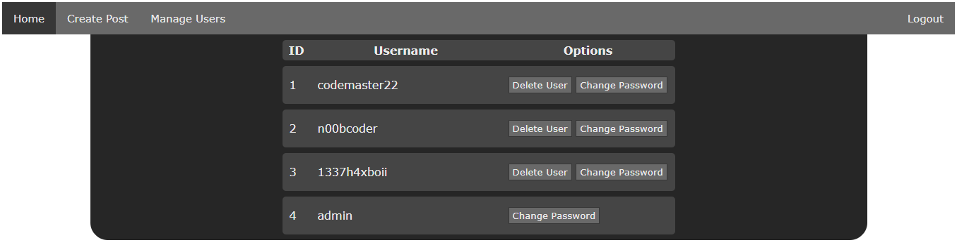

Slide 11
Improvements
More CSS to make the website truly look ‘modern’
Add more features for a user
Upload pictures
Search for posts
Subscribe to posts
Subscribe to Users
Subscribe to forums
Animations to make the flow of the site seamless
Organize the HTML and CSS to make the source code more logical and easy to read
Add pages to the home page and discard old posts

